Slide 1
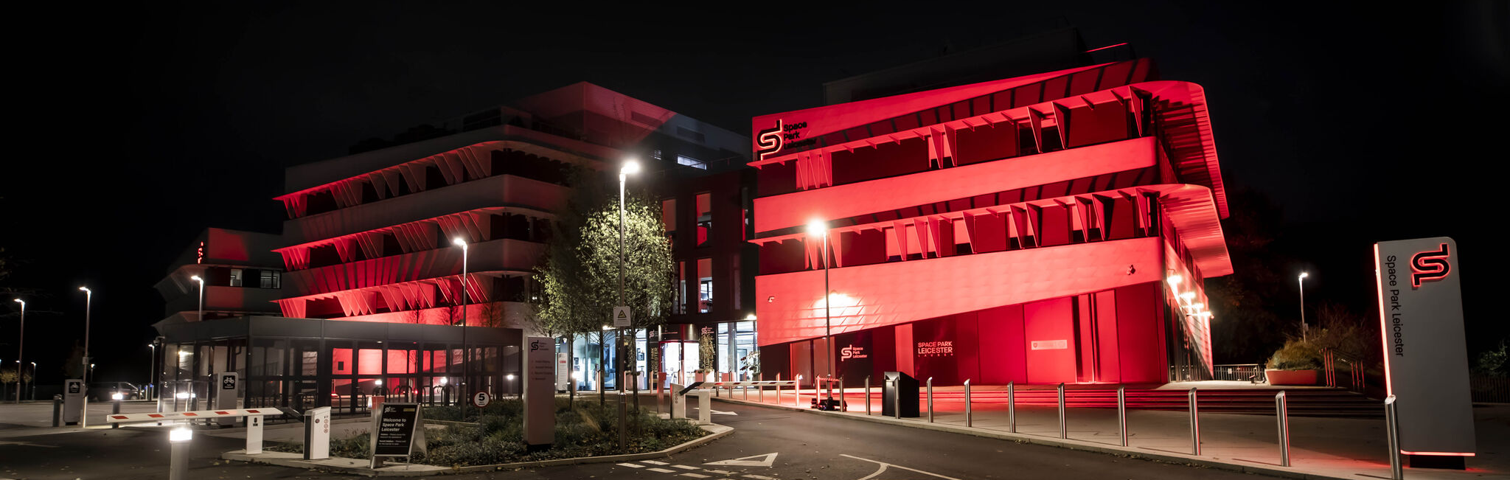
Mission Patch Design Challenge
Space Park Leicester

Slide 2
Mission Patch Design Challenge
Space missions are known for their eye-catching mission patches.
To support Space Park Leicester’s mission we are inviting you to help design our Mission Patch. The winning designs will receive stickers of their Mission Patch and our artist will use them as inspiration for the finalised patch.
To enter, draw your patch design and write a few sentences explaining
why you chose each element.
The Apollo 11 patch included a depiction of the Moon as it was the destination
of the mission. It included an Eagle to represent the USA and the olive branch
was chosen to highlight the missions peaceful aims. Famously the US flag and
Names of the astronauts were omitted to highlight this mission was for all of humanity.

Slide 3
Additional Mission Patch Stories
For Tim Peake’s Principia mission, the patch designer included a falling apple to represent Sir Isaac Newton, who’s book Principia helped us understand gravity. The reflection on the apple is shaped like the International Space Station, which is where Tim went.
The Muninn mission was named after a raven, which features on the patch. It includes a silhouette of Sweden, the astronauts home country. The stars are the Viking rune for protection, paying homage to the countries origins.
Designed by an Italian designer the Apollo 15 badge had 3 stylised birds to represent the crew. The background was the planned landing site with a slight tweak. Emilio Pucci hid the roman numerals for the mission number in the walls of several craters.

Slide 4
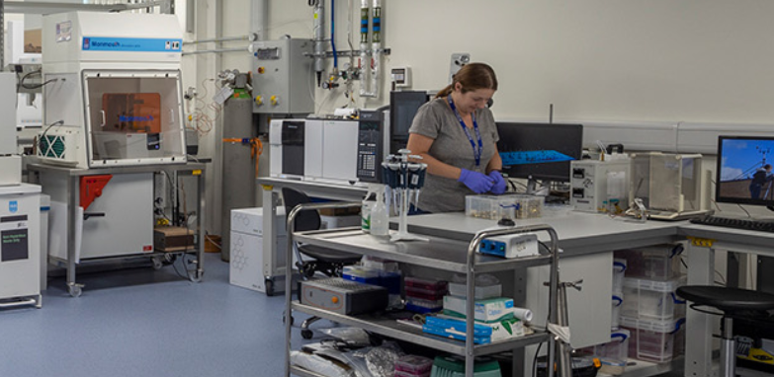
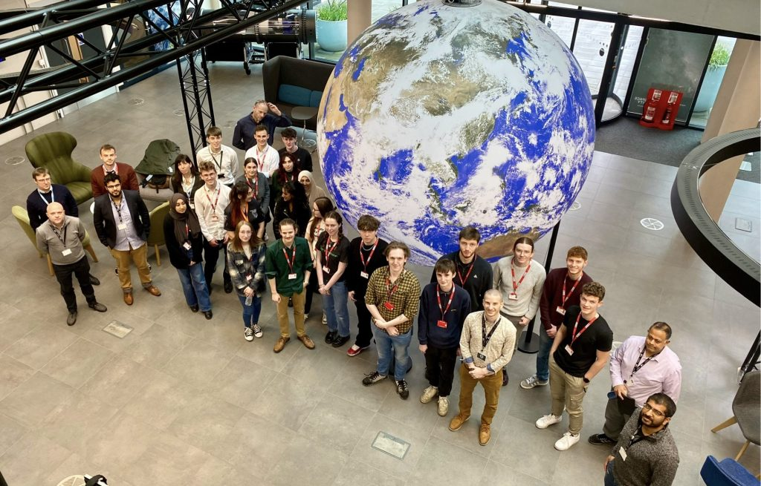
Space Park Leicester’s Mission
Drive impactful, inspirational, world-leading research
Deliver a pipeline of education, skills, and training
Cement the city as the place for forward-thinking collaborative venture

Slide 5
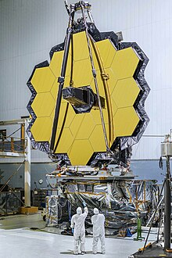
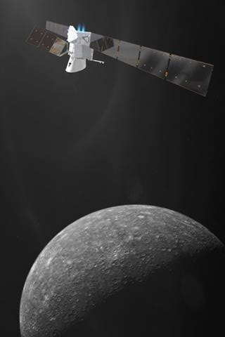
Space Park Leicester’s Big Projects
BepiColombo is on its way to investigate Mercury
Exomars will study Mars as we build a lab for the first Mars rocks to be brought to Earth
We built one of the instruments on The Webb Telescope
SMILE will study the Earth’s magnetic field
SVOM will use X-Rays to peer deep into space to study the Universe’s most powerful explosions

Slide 6
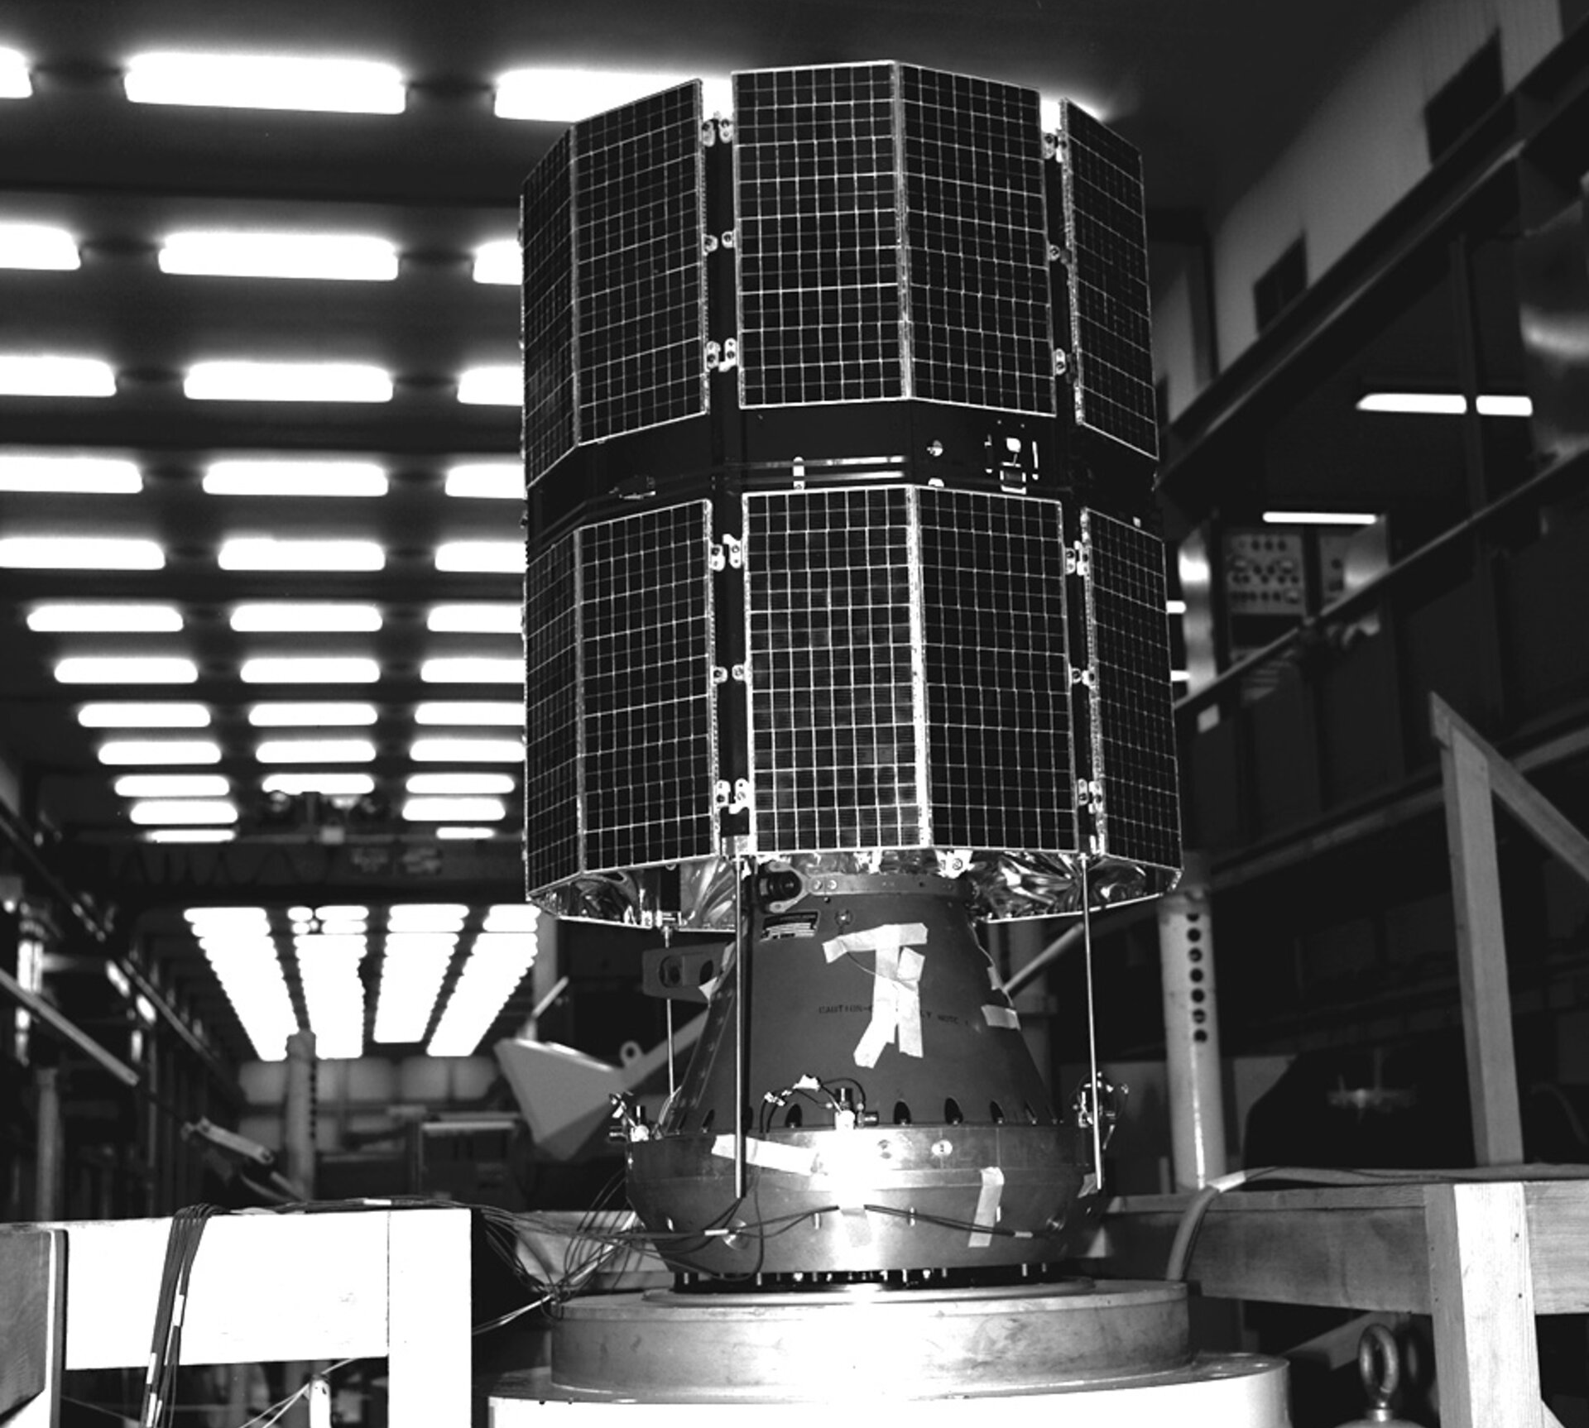
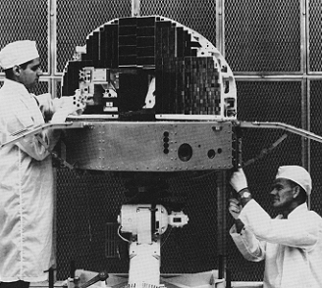
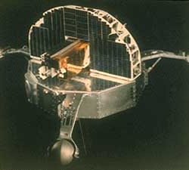
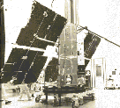
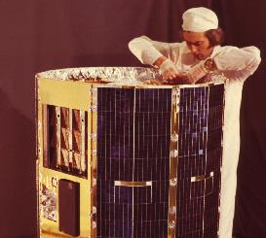
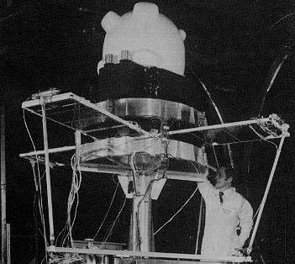
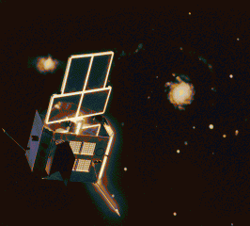
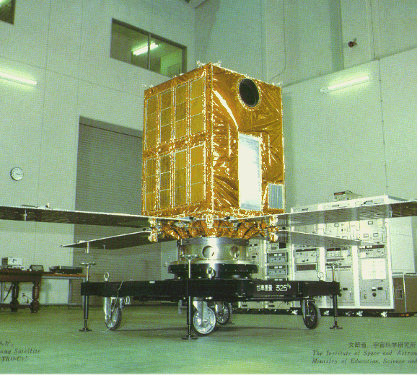
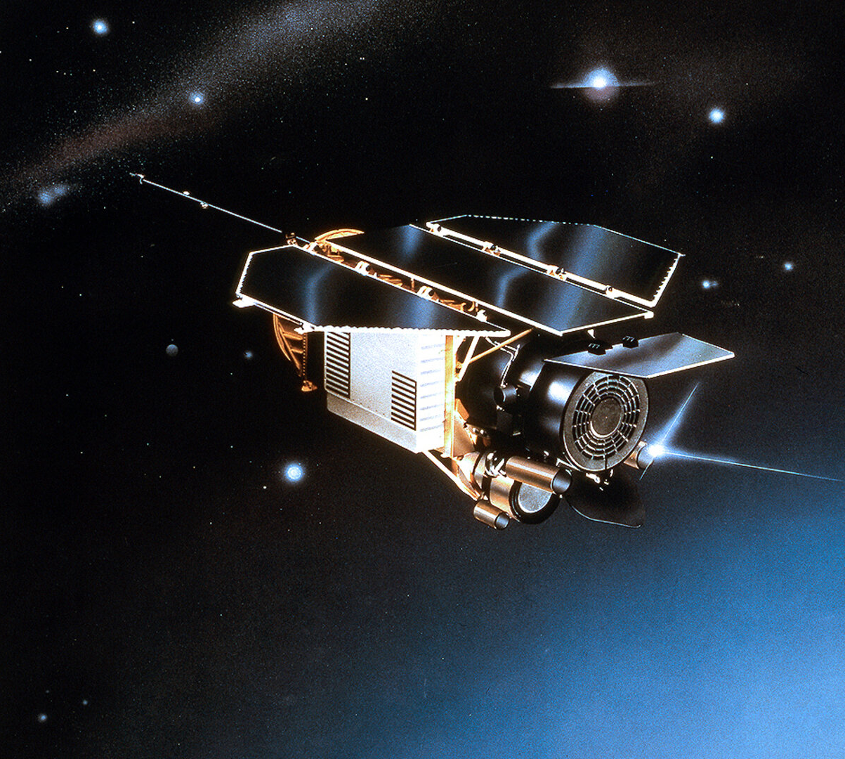
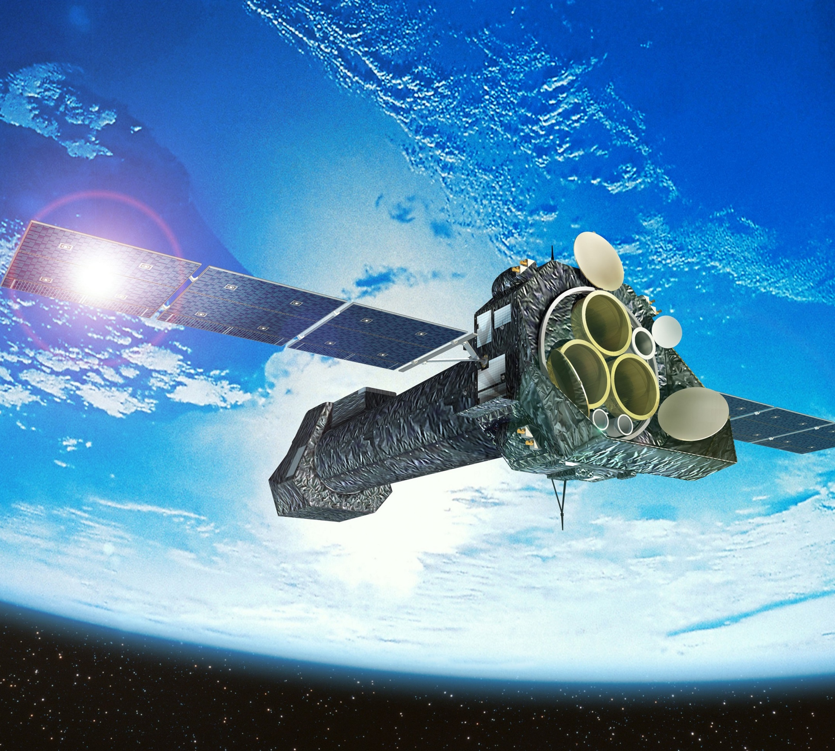
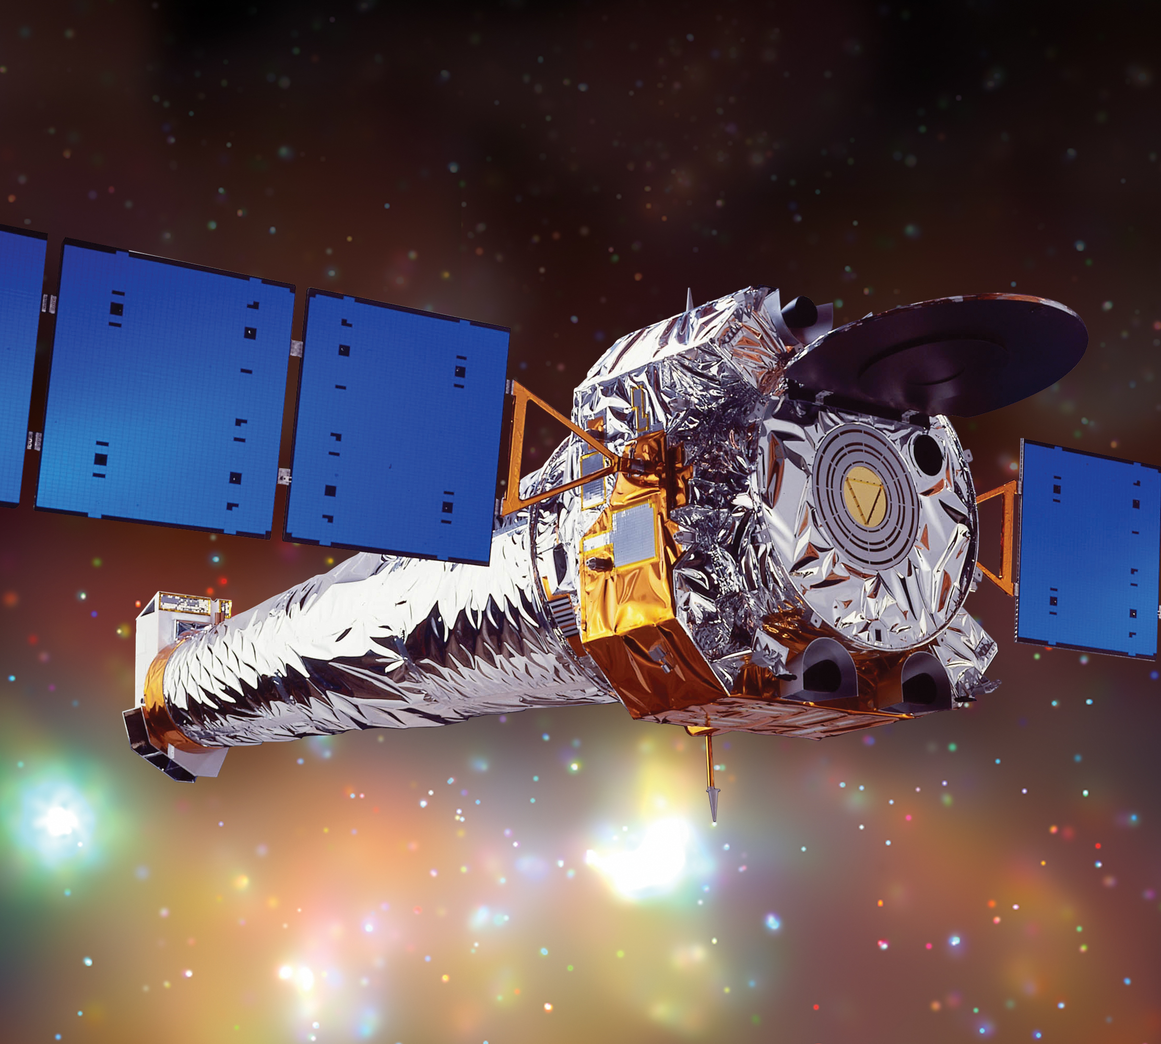
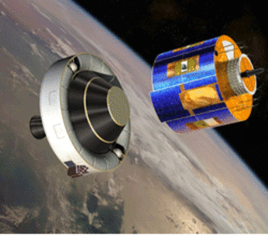
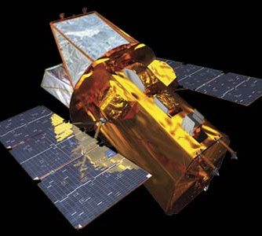
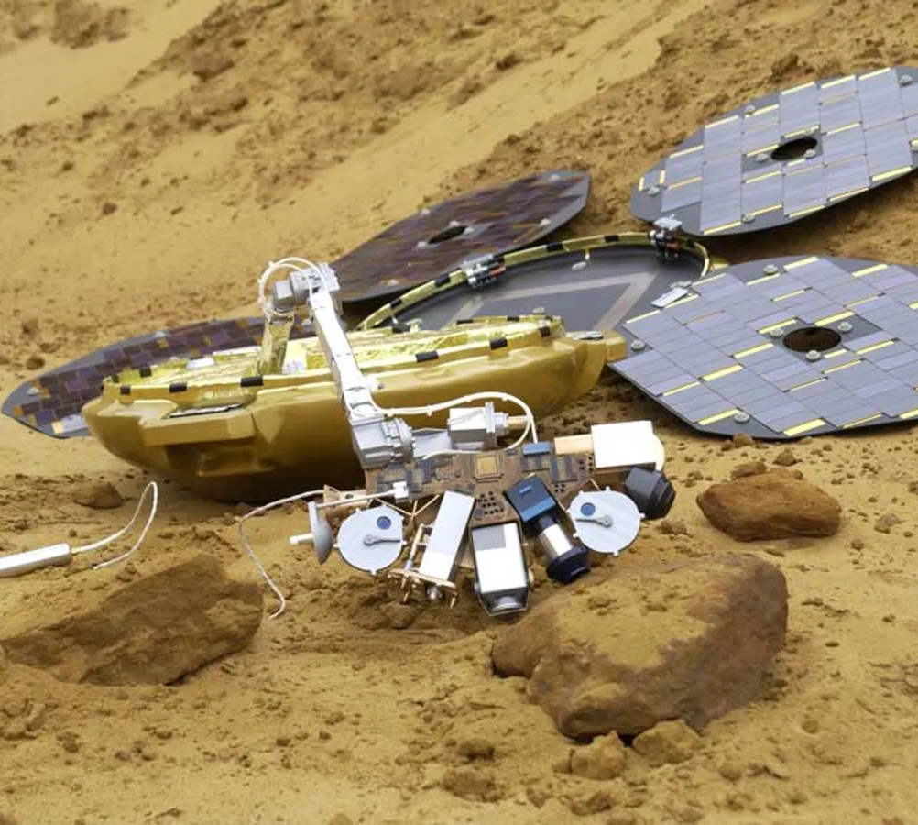
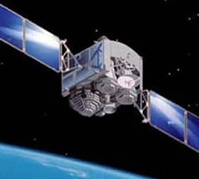
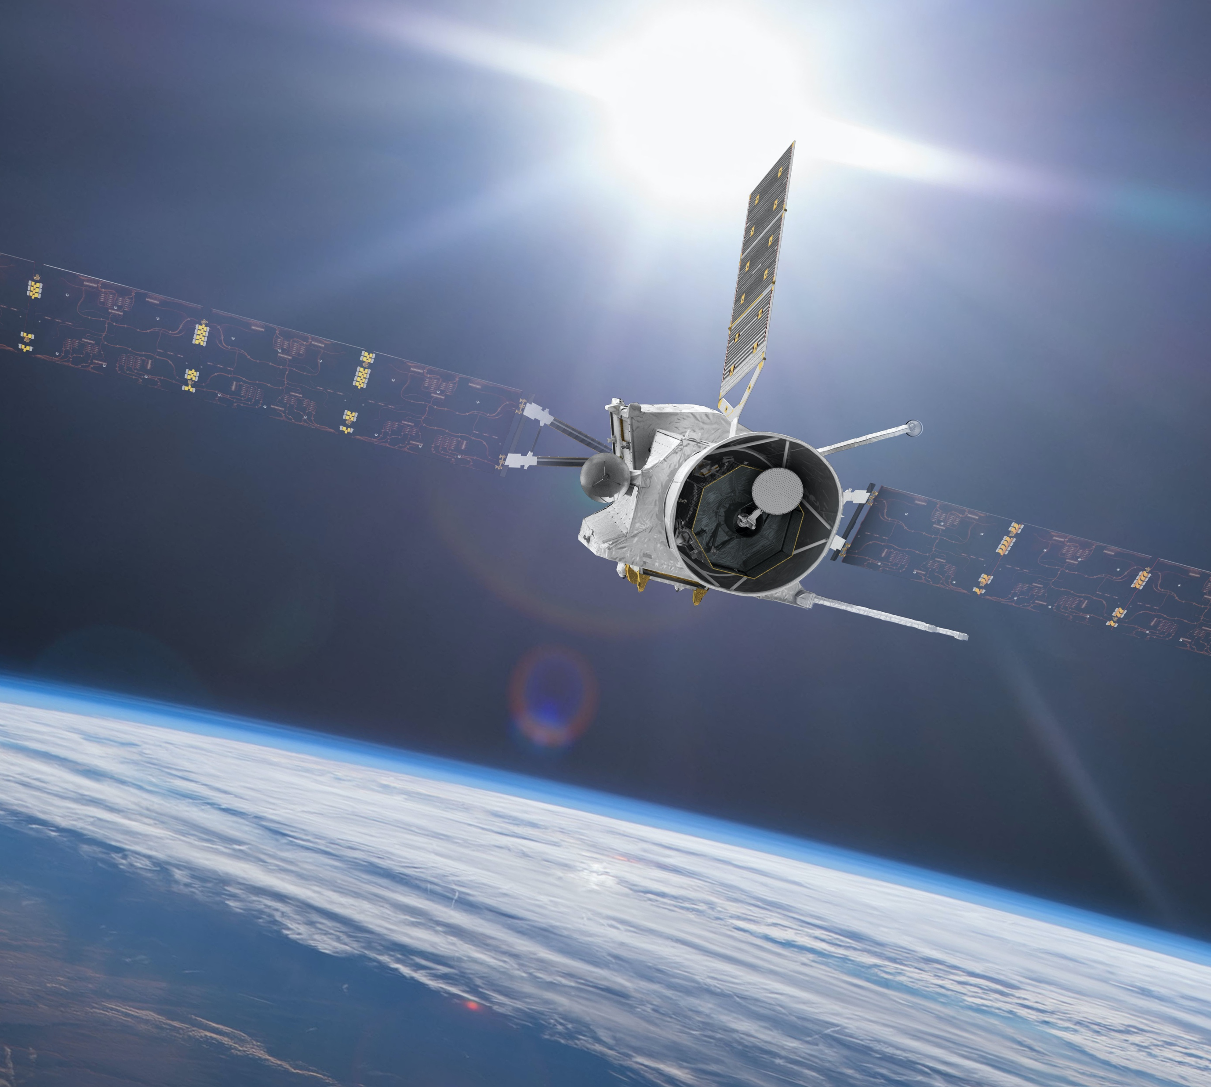
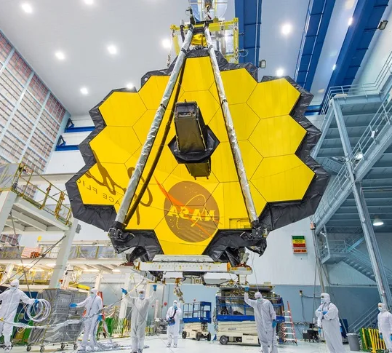
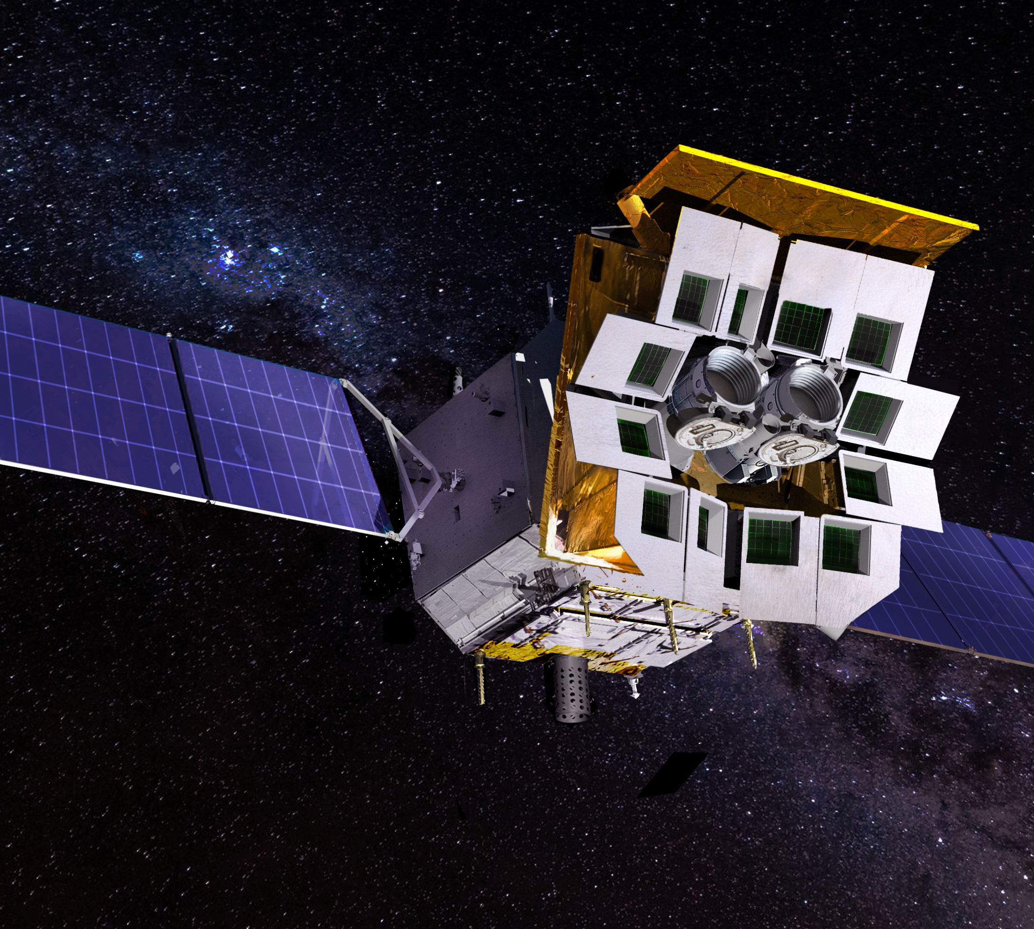
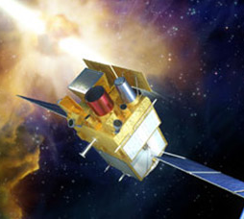
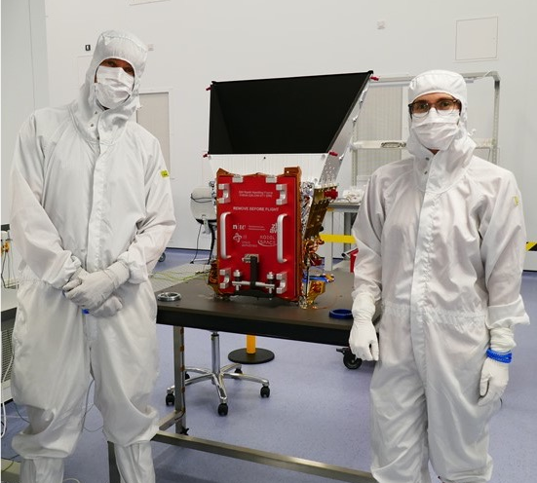
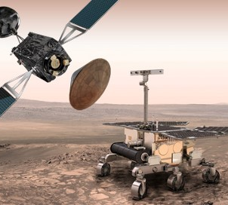
More than 60 years of Space Innovation
1960 Space at Leicester established Now 300+ researchers
Record >90 missions, 10 operational instruments now, >1 active in orbit every year since 1967
Skills Largest concentration of space-focused expertise in space education from school pupils to PhDs
End-to-End capability From science concept to operational mission
1960s
1970s
1980s
SKYLARK
ARIEL-1
ESRO 2
OSO-4
OSO-5
COPERNICUS
ARIEL-5
ARIEL-6
EXOSAT
1990s
2000s
2010s
GINGA
ROSAT
XMM NEWTON
CHANDRA
METEOSAT
SWIFT
BEAGLE 2
ASTROSAT
BEPI COLOMBO
2020s
JAMES WEBB
JUICE
EINSTEIN PROBE
SVOM
SMILE
EXOMARS
MISSIONS TO BE LAUNCHED

Slide 7
More than 60 years of Space Innovation
1960s
1970s
1980s
SKYLARK
ARIEL-1
ESRO 2
OSO-4
OSO-5
COPERNICUS
ARIEL-5
ARIEL-6
EXOSAT
1990s
2000s
2010s
GINGA
ROSAT
XMM NEWTON
CHANDRA
METEOSAT
SWIFT
BEAGLE 2
ASTROSAT
BEPI COLOMBO
2020s
MISSIONS TO BE LAUNCHED
JAMES WEBB
JUICE
EINSTEIN PROBE
SVOM
SMILE
EXOMARS

Slide 8
Mission Patch Design Challenge
Submit a photo of your design via email: Outreach@space-park.co.uk
Or on X: @SpaceParkLeic using #SpacePatchLeicester
Good Luck

